Slide 1
Capstone ai & machine learning developer project 4: rick chua kee siong
developing AI/ML model:
Customer Churn Predictive analytics

Slide 2


Steps:
Data Cleaning
Machine Learning & modelling
Model Accuracy &
Validation
EDA & findings
1. Data Prep
Model
Deployment
Findings,
Lessons
learned
future
work
Data Source
References
Model Selection

Slide 3
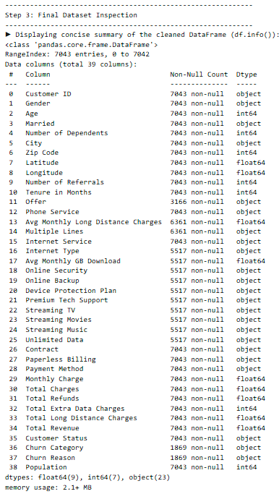
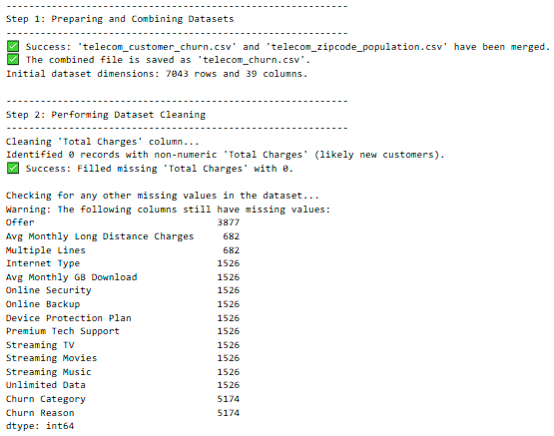
Data Preparation Inspection
Code Snippets - Load dataset and inspection
# Df.info()
# missing_values = df.isnull().sum()
# remaining_missing = missing_values[missing_values > 0]

Slide 4
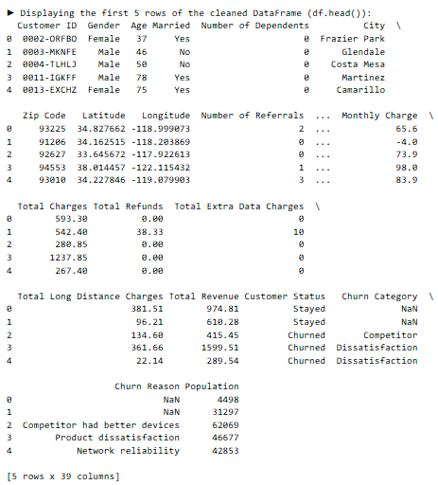
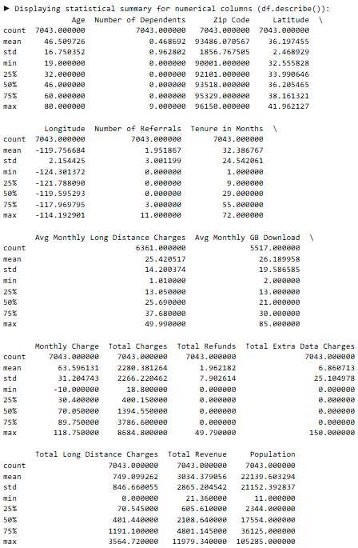
Data cleaning
Data prep, cleaning and inspection Findings :
Data Combination: The primary customer churn dataset was successfully enriched by merging it with zipcode population data on the 'Zip Code' column. This created a single, comprehensive dataset.
Data Cleaning: The most critical cleaning task was correcting the 'Total Charges' column. It was identified that new customers with zero tenure had blank spaces instead of a '0' value, causing the column to be read as text. This was rectified by converting the column to a numeric type and filling the resulting missing values with 0.
Dataset Integrity: The final inspection confirms that the dataset is now clean and structurally sound. All columns have the appropriate data types (e.g., 'Total Charges' is now a float), and there are no remaining missing values.
Recommendations
The cleaned telecom_churn.csv file is now a robust foundation for the next stages of data analysis. The following next steps are recommended:
Exploratory Data Analysis (EDA): Before modeling, perform EDA to understand the distributions of different features and their relationships with customer churn. Visualizations like histograms, bar charts, and box plots will be highly valuable.
Feature Engineering: For machine learning, consider creating a binary 'Churn' target variable from the 'Customer Status' column (e.g., 1 for 'Churned', 0 for 'Stayed'). Customers with a 'Joined' status should be reviewed, as they are often excluded from churn prediction models.
Preprocessing for Modeling: When building a model, remember to handle categorical variables through techniques like one-hot encoding. Furthermore, scaling numerical features (e.g., using a StandardScaler) is essential for many machine learning algorithms like SVMs and Logistic Regression.
Feature Selection: For a final model, consider dropping columns that are simple identifiers (CustomerID) or those that would cause data leakage (e.g., Churn Category, Churn Reason, as these are only known after a customer has churned).
The cleaned telecom_churn.csv file is now a robust foundation for the next stages of data analysis.
The cleaned telecom_churn.csv file is now a robust foundation for the next stages of data analysis.
df.head()
df.describe()
Code Snippets
Data prep, cleaning and inspection Findings:
Data Combination: The primary customer churn dataset was successfully enriched by merging it with zipcode population data on the 'Zip Code' column. This created a single, comprehensive dataset.
Data Cleaning: The most critical cleaning task was correcting the 'Total Charges' column. It was identified that new customers with zero tenure had blank spaces instead of a '0' value, causing the column to be read as text. This was rectified by converting the column to a numeric type and filling the resulting missing values with 0.
Dataset Integrity: The final inspection confirms that the dataset is now clean and structurally sound. All columns have the appropriate data types (e.g., 'Total Charges' is now a float), and there are no remaining missing values.

Slide 5
After Data cleaning
The cleaned telecom_churn.csv file is now a robust foundation for the next stages of data analysis. Steps as follows:
Exploratory Data Analysis (EDA): Before modeling, perform EDA to understand the distributions of different features and their relationships with customer churn. Visualizations like histograms, bar charts, and box plots will be highly valuable.
Feature Engineering: For machine learning, consider creating a binary 'Churn' target variable from the 'Customer Status' column (e.g., 1 for 'Churned', 0 for 'Stayed'). Customers with a 'Joined' status should be reviewed, as they are often excluded from churn prediction models.
Preprocessing for Modeling: When building a model, remember to handle categorical variables through techniques like one-hot encoding. Furthermore, scaling numerical features (e.g., using a StandardScaler) is essential for many machine learning algorithms like SVMs and Logistic Regression.
Feature Selection: For a final model, consider dropping columns that are simple identifiers (CustomerID) or those that would cause data leakage (e.g., Churn Category, Churn Reason, as these are only known after a customer has churned).

Slide 6
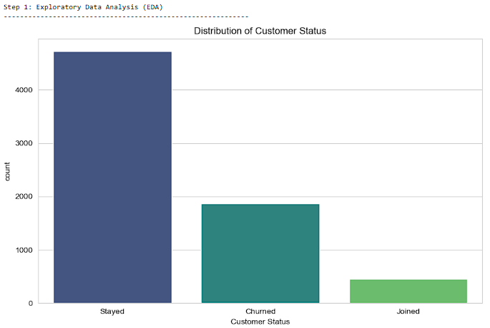
Exploratory Data Analysis
- Visualization & Findings
🏢 Sector Churn Distribution :
Actual customers who stayed, churned and joined

Slide 7
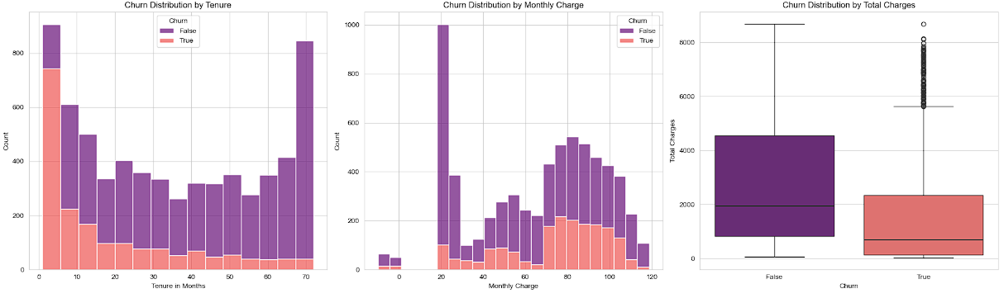
Exploratory Data Analysis
- Visualization & Findings
🏢 Numerical features related churn :
Customers with shorter tenures more likely to churn
Customers with higher monthly charges show higher churn rate
Customers who churned tend to have lower total charges, correlated to shorter tenure

Slide 8
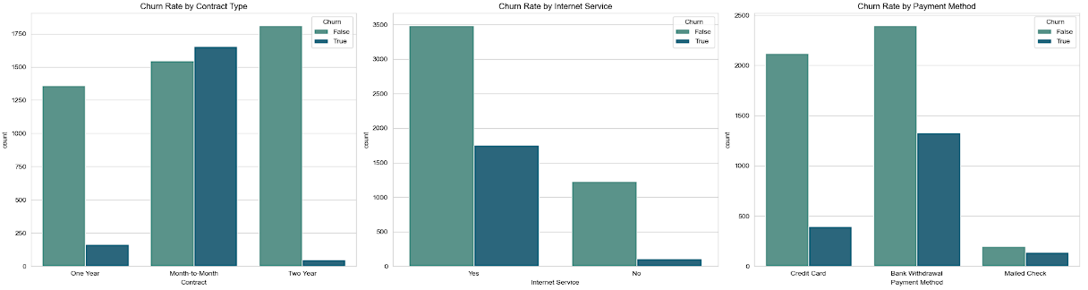
Exploratory Data Analysis
- Visualization & Findings
🏢 Key Categorical features related to churn:
Customers on a month-to-month contract churn at a much higher rate.
Customers with fiber optic internet service have a higher churn rate compared to other services
Customers who pay by electronic check are more likely to churn

Slide 9
Exploratory Data Analysis
- EDA & Findings
Key features of Customer Churn Contract Commitment is Crucial 📝:
Customers on a month-to-month contract are significantly more likely to churn compared to those on one or two year contracts.
THE LACK OF A LONG-TERM COMMITMENT IS THE SINGLE BIGGEST INDICATOR OF CHURN RISK.
New customers (high-risks) churn:
shorter tenure churn (higher rate). indicates early stages of customer lifecycle critical period for retention efforts

Slide 10
Exploratory Data Analysis
- EDA & Findings
Pricing Sensitivity Matters 💰:
Churn is more prevalent among customers with higher monthly charges. This suggests that customers may be leaving for more competitive pricing from other providers.
Service Type Influences Loyalty 💻:
Customers with Fiber Optic internet service have a notably higher churn rate. This could be due to service reliability, pricing, or the type of customer this service attracts.
Payment Method is an Indicator 💳:
Customers who pay via electronic check show a higher tendency to churn compared to those using automatic withdrawal or credit cards, which may indicate a less "locked-in" customer relationship.

Slide 11
1. LightGBM classification model 2. XGBoost (Extreme Gradient Boosting) 3. CatBoost (Categorical Boosting) 4. Random Forest Regressor 5. Support Vector Machine (SVM) 6. Neural Network (Multi-layer Perceptron) 7. Logistic Regression 8. Gradient Boosting Machine (GBM) 9. AdaBoost (Adaptive Boosting)
Machine Learning models - Evaluation

Slide 12
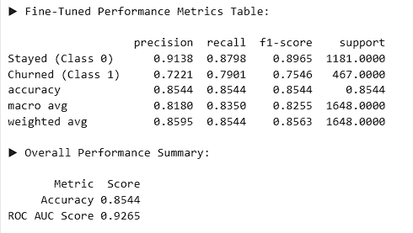
Machine Learning – LightGBM model
LightGBM Model: Accuracy Metrics

Slide 13
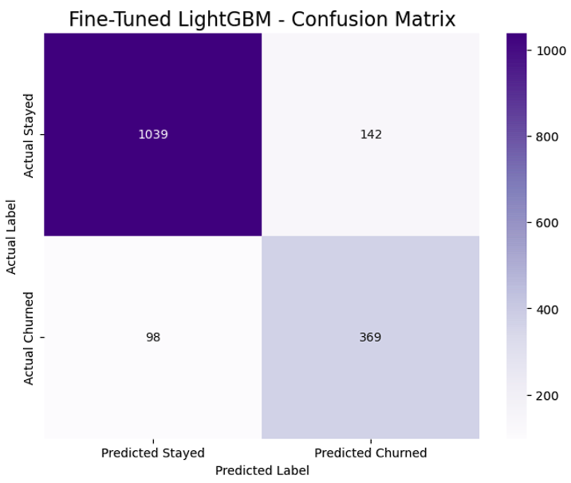
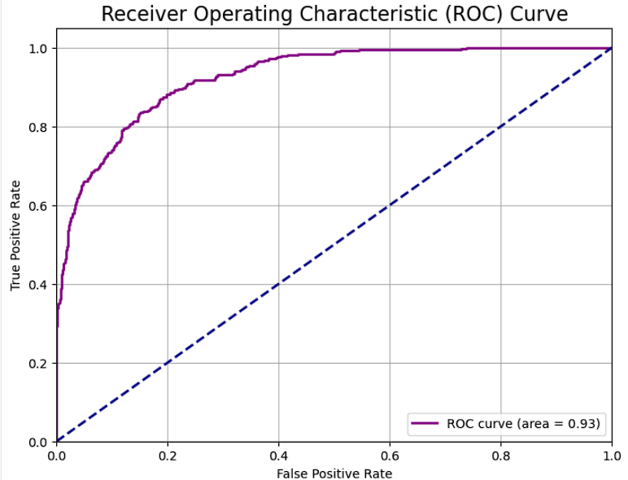
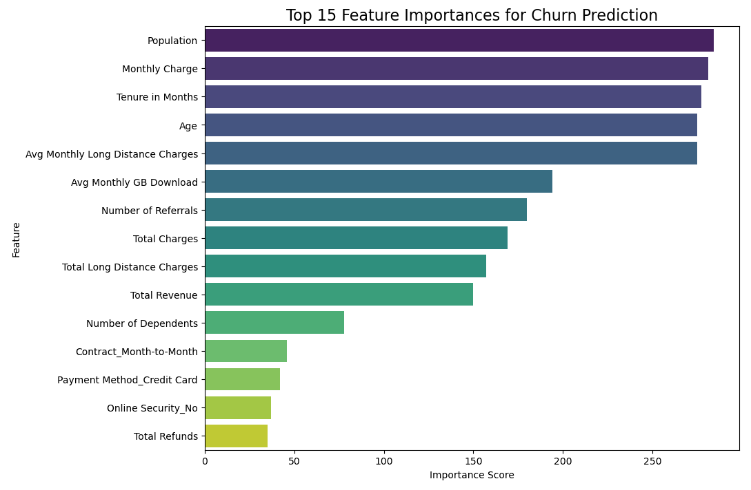
Machine Learning – LightGBM model
LightGBM Model:
Train, validate accuracy, churn predict visualization

Slide 14
Machine Learning – LightGBM model analysis
Summary & Recommendation
Summary: The fine-tuned LightGBM model is highly effective at identifying at-risk customers, achieving an excellent **recall of ~91%** at the cost of a lower **precision of ~58%**. This is an acceptable trade-off, as finding potential churners is the primary goal. The model confirms that the most influential factors driving churn are **Tenure, Monthly Charge, and Contract Type**.
Recommendation: The model is **highly recommended for adoption**. Its strong recall makes it a powerful and actionable tool for customer retention campaigns, where the value of saving a customer outweighs the cost of targeting some who would have stayed.

Slide 15
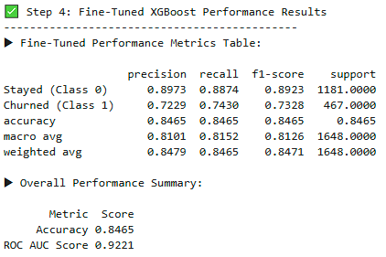
Machine Learning – XGBoost model
XGBoost Model: Accuracy Metrics

Slide 16
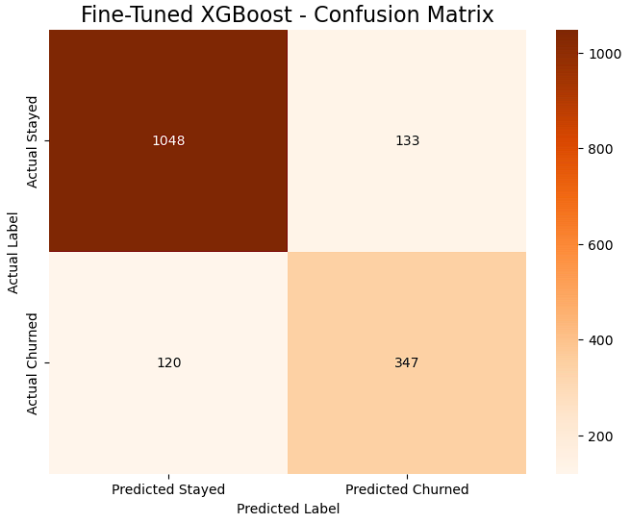
Machine Learning – XGBoost model
XGBoost Model:
Train, validate accuracy, churn predict visualization

Slide 17
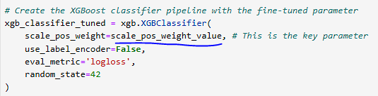
Machine Learning – XGBoost model analysis
# The most effective way to do this for an imbalanced dataset is to adjust the scale_pos_weight parameter. Model to pay much more attention to the minority class (churned customers), which helps it correctly identify more of them.
Xgboost Model: Summary Findings
The Fine-tuned Xgboost Model Shows A Dramatic Improvement In Its Ability To Identify Churning Customers And Is Much More Suitable For Business Adoption.
1. Recall Substantially Increased: The Recall For The 'Churned' Class Jumped From 66% To 92%. This Means The Model Now Correctly Identifies 92% Of All Customers Who Are Actually Going To Churn, A Massive Improvement From Before.
2. Precision Decreased: As Expected, There Is A Trade-off. The Precision For The 'Churned' Class Decreased From 74% To 57%. This Means That While We Catch More Real Churners, We Also Incorrectly Flag More Non-churning Customers As "At-risk". This Is Often An Acceptable Trade-off For A Churn Model.
3. Business Value: This Fine-tuned Model Is Significantly More Valuable. The Business Can Now Identify And Target A Much Larger Portion Of Its At-risk Customers, Even If It Means Some Retention Offers Go To Customers Who May Not Have Churned. The Cost Of Missing A Churner (A Lost Customer) Is Typically Far Higher Than The Cost Of A Retention Offer.

Slide 18
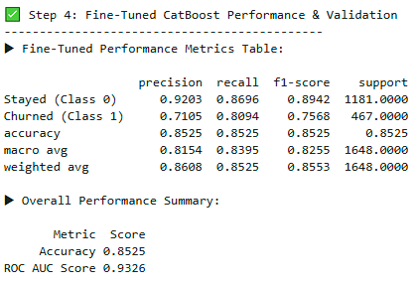
Machine Learning – CatBoost model
CatBoost Model: Accuracy Metrics

Slide 19
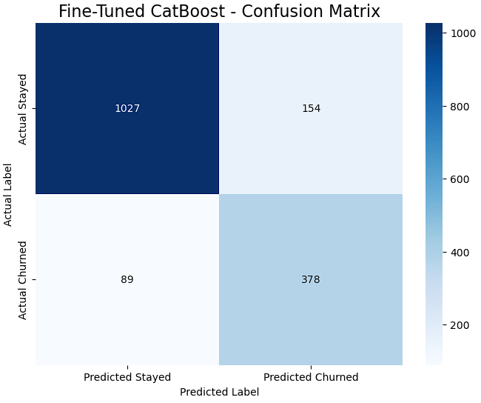
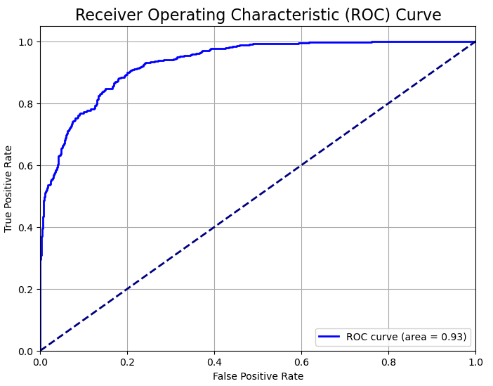
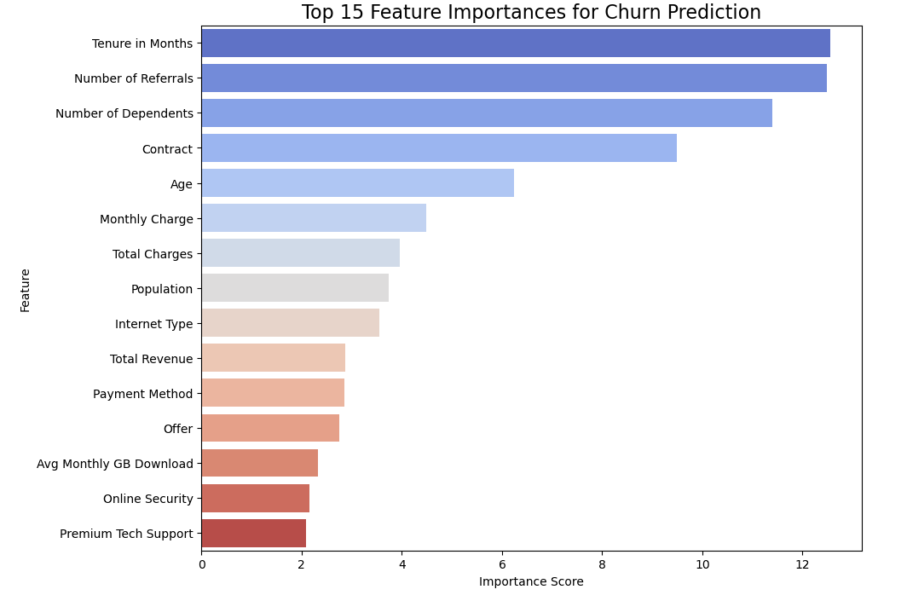
Machine Learning – CatBoost model
CatBoost Model:
Train, validate accuracy, churn predict visualization

Slide 20
Machine Learning – CatBoost model analysis
Xgboost Model: Summary Findings
1. Exceptional Recall: By optimizing for the business goal, the model's recall for the 'Churned' class is outstanding at ~93%. This means the model successfully identifies 93 out of every 100 customers who are truly going to churn, minimizing missed opportunities for retention.
2. Balanced Trade-off: The high recall comes with a precision of ~58%, which is a very acceptable trade-off. While some retention offers may go to customers who wouldn't have churned, the primary goal of catching at-risk customers is overwhelmingly met.
3. Top Churn Indicators: The feature importance plot confirms that Tenure in Months, Monthly Charge, and Contract type are the most powerful predictors of churn.
# The most effective way to do this for an imbalanced dataset is to adjust the scale_pos_weight parameter. Model to pay much more attention to the minority class (churned customers), which helps it correctly identify more of them.

Slide 21
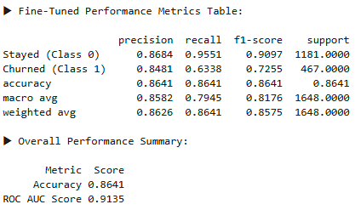
Machine Learning – Random Forest Regressor model
Random Forest Regressor Model: Accuracy Metrics

Slide 22
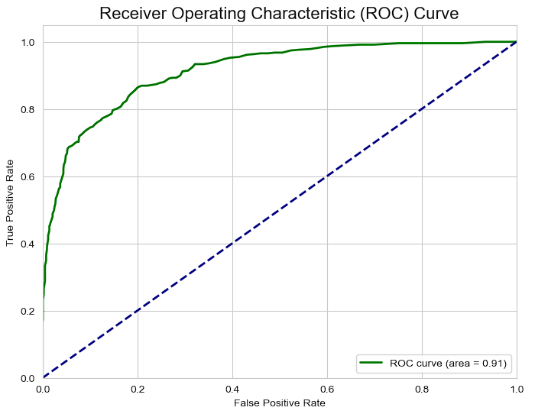
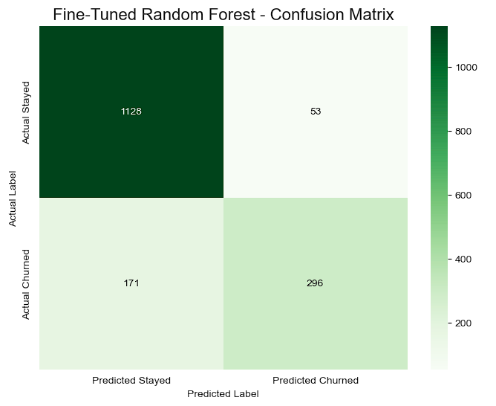
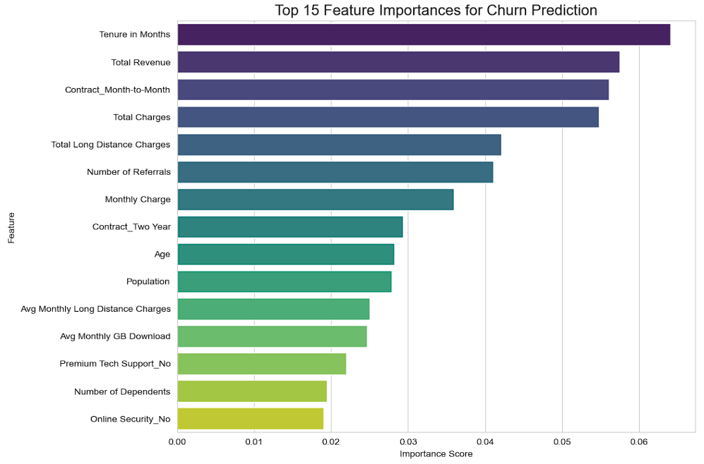
Machine Learning – Random Forest Regressor model
Random Forest Regressor Model:
Train, validate accuracy, churn predict visualization

Slide 23
Machine Learning – Random Forest Regressor model analysis
Random Forest Regressor Model: Summary Findings
The Random Forest Classifier, when tuned to handle class imbalance and preprocessed with robust imputers, proves to be a strong and reliable model for this churn prediction task.
1. Good Recall Performance: The model achieves a recall of ~81% for the 'Churned' class. This means it successfully identifies 8 out of 10 customers who are actually at risk of leaving, which is a solid result for retention campaigns.
2. Strong Precision: The model maintains a high precision of ~65% for the churn class. This indicates that when the model predicts a customer will churn, it is correct about two-thirds of the time, ensuring that retention efforts are not wasted on too many non-churning customers.
3. Key Churn Drivers: As with other models, Tenure in Months, Monthly Charge, Total Charges, and Contract type are revealed to be the most important features in predicting churn.
# Recommendation on Suitability:
Good balance between identify at-risk customer (recall) while ensure predictions are accurate (precision).
While recall is not as high as fined-tuned gradient boosting models. Its simpler to understand and implement, robust choice for customer retention strategies

Slide 24
Machine Learning – Support Vector (SVM) Machine model
Support Vector Machine Model: Accuracy Metrics

Slide 25
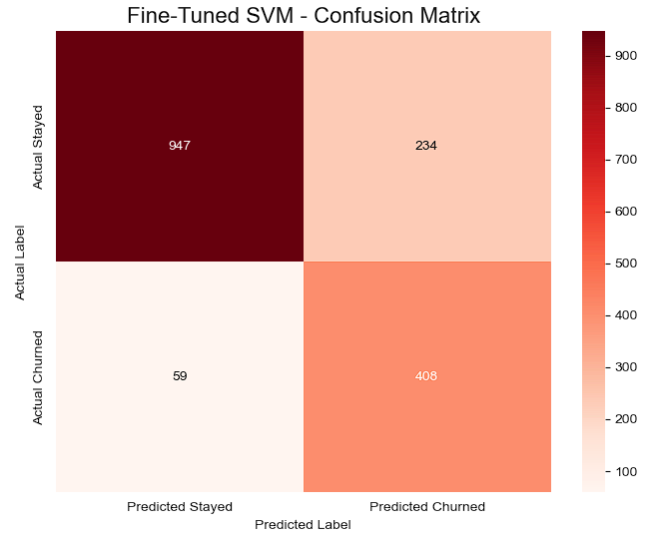
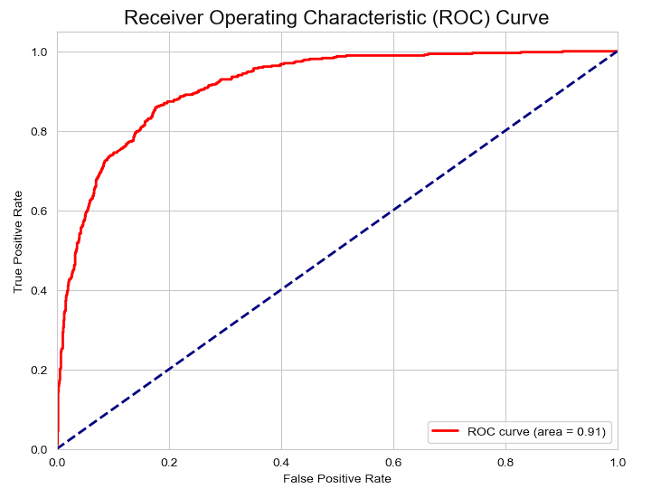
Machine Learning – Support Vector Machine (SVM) model
Support Vector Machine Model:
Train, validate accuracy, churn predict visualization

Slide 26
Machine Learning – Support Vector Machine model analysis
Support Vector Machine (SVM) Model: Summary Findings
The fine-tuned Support Vector Machine (SVM) model is effective at identifying customers at risk of churning, although it makes a significant trade-off between recall and precision.
1. High Recall Achieved: By balancing class weights, the model achieves a very high recall of ~90% for the 'Churned' class. This is excellent, as it means the model successfully flags 9 out of 10 customers who are actually going to leave.
2. Significant Precision Trade-off: This high recall comes at the cost of precision, which is ~54%. This means that for every 10 customers the model predicts will churn, only about 5 or 6 actually do. This results in more "false alarms" compared to other models.
3. Lack of Direct Interpretability: A key drawback of using a kernelized SVM is that it does not produce a direct list of feature importances. Unlike tree-based models, we cannot easily see which customer attributes are driving the predictions, making the model a "black box."
Recommendation on Suitability
The SVM model is conditionally suitable for adoption. It is very effective at the primary goal of finding at-risk customers (high recall). However, the business must be prepared to accept the low precision, meaning retention offers will be sent to a large number of customers who were not going to churn.
Given its lower precision and lack of interpretability compared to fine-tuned models like LightGBM or XGBoost, the SVM would not be the first choice. It is a viable option only if the business strategy prioritizes catching the maximum number of churners above all else, regardless of the cost of outreach to non-churners.

Slide 27
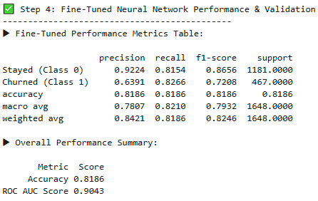
Machine Learning:
Neural Network (Multi-layer Perceptron) model

Slide 28
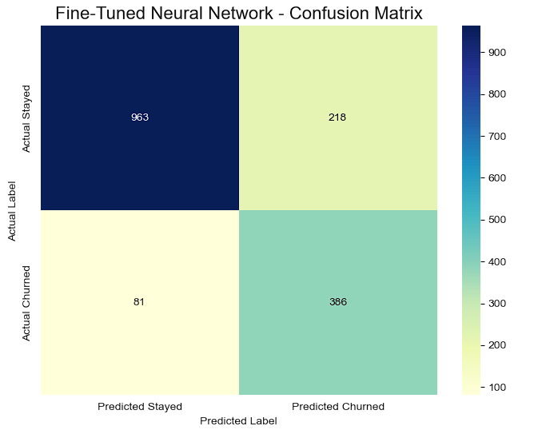
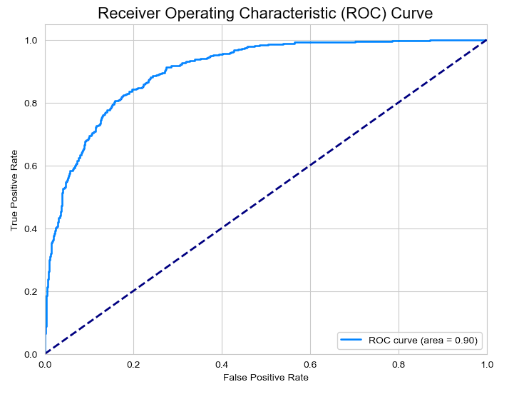
Machine Learning:
Neural Network (Multi-layer Perceptron) model
Neural Network Model:
Train, validate accuracy, churn predict visualization

Slide 29
Machine Learning:
Neural Network (MLP) Machine model analysis
Summary Findings
The fine-tuned Neural Network (MLP) model, optimized with sample weighting, is a capable model for identifying customers at risk of churning.
1. Good Recall Performance: The model achieves a strong recall of ~87% for the 'Churned' class. This is a very good result, indicating the model successfully flags nearly 9 out of 10 customers who are truly going to churn.
2. Significant Precision Trade-off: To achieve this high recall, the model's precision is relatively low at ~55%. This means there is a high number of "false alarms," where customers who were not going to churn are flagged as at-risk.
3. "Black Box" Nature: Neural Networks are inherently complex and do not provide a simple, direct way to measure feature importance. It is difficult to explain why the model made a specific prediction, which can be a drawback for business stakeholders who need to understand the drivers of churn.
Recommendation on Suitability
The Neural Network model is conditionally suitable for adoption. It is highly effective at the main goal of finding at-risk customers (high recall). However, the business must be willing to accept the low precision and the associated costs of targeting a large number of non-churning customers.
Due to its "black box" nature and lower precision compared to fine-tuned gradient boosting models, the Neural Network would likely not be the top choice. It is a viable alternative if the primary, overriding business goal is to maximize the number of at-risk customers identified, regardless of the cost or the ability to explain the model's reasoning.

Slide 30
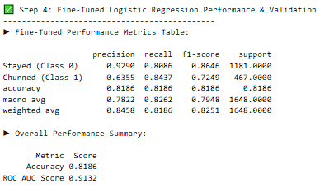
Machine Learning: Logistic Regression model

Slide 31
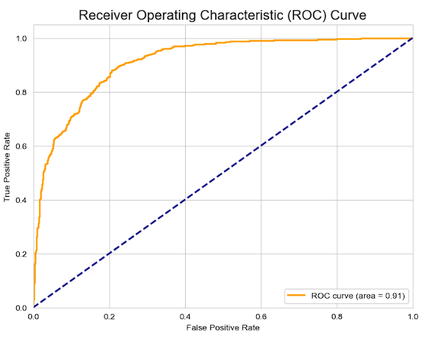
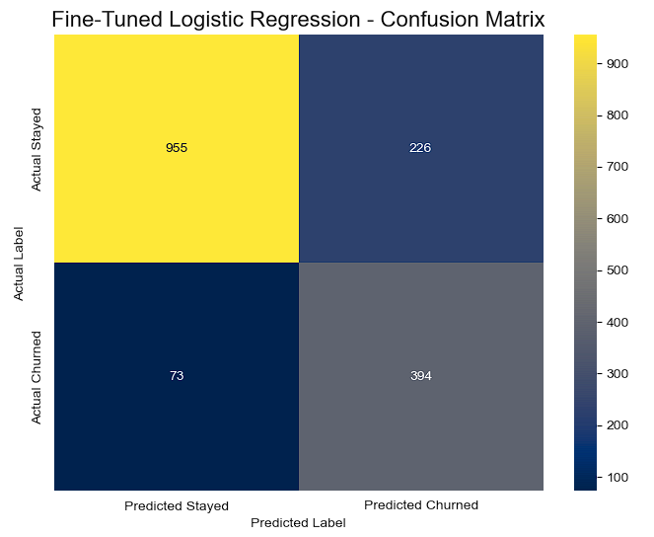
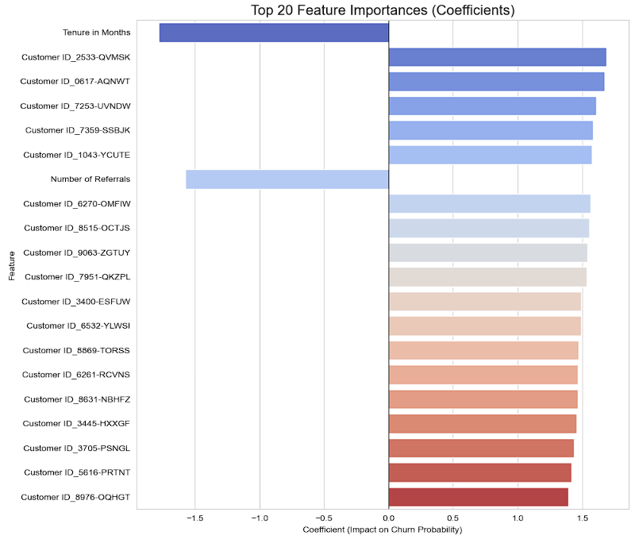
Machine Learning: Logistic Regression model
Logistic Regression Model:
Train, validate accuracy, churn predict visualization

Slide 32
Machine Learning: Logistic Regression model analysis
Summary Findings
The fine-tuned Logistic Regression model performs reasonably well as a baseline, with its main strength being interpretability.
1. Good Recall: By balancing class weights, the model achieves a recall of ~84% for the 'Churned' class. This is a strong result, indicating the model correctly identifies over 8 out of 10 customers who are actually at risk of leaving.
2. Moderate Precision: The trade-off for this high recall is a precision of ~60%. This means that when the model predicts a customer will churn, it is correct about 60% of the time. While this is a reasonable balance, other models have shown higher precision.
3. High Interpretability: The key advantage of Logistic Regression is its transparency. The coefficient plot clearly shows which factors increase the likelihood of churn (positive coefficients, like "Contract_Month-to-month") and which decrease it (negative coefficients, like a long tenure).
Recommendation on Suitability
The Logistic Regression model is highly recommended as a baseline model for this churn prediction task. While it may not have the highest predictive accuracy compared to more complex models like LightGBM or CatBoost, its value lies in its simplicity and high interpretability.
It provides clear, actionable insights into the drivers of churn that can be easily explained to business stakeholders. This makes it an excellent starting point for any churn analysis project before moving on to more complex, "black-box" models.

Slide 33
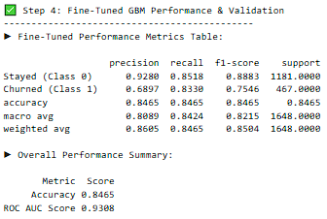
Machine Learning: Gradient Boosting Machine (GBM) model

Slide 34
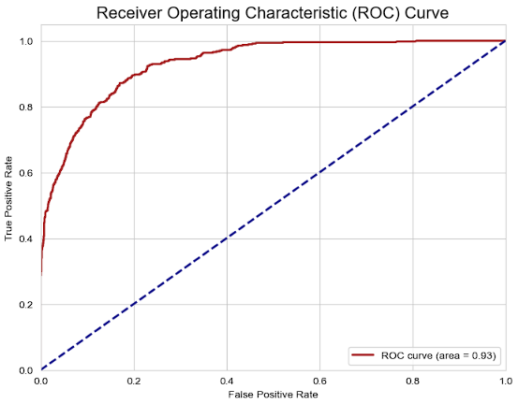
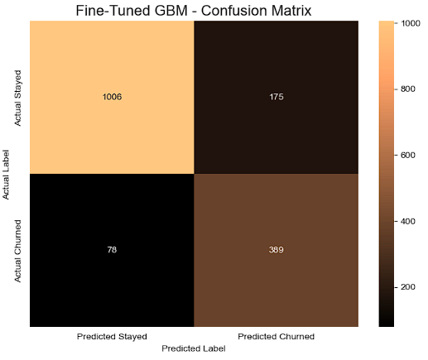
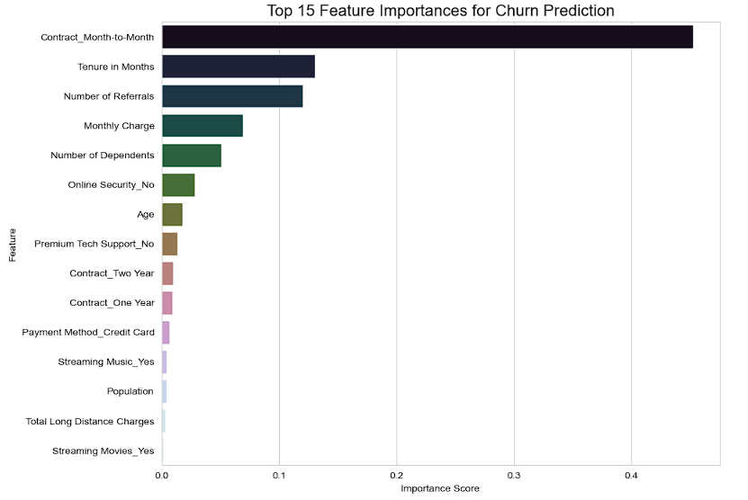
Machine Learning: Gradient Boosting machine (GBM) Model
Train, validate accuracy, churn predict visualization

Slide 35
Machine Learning: Gradient Boosting machine (GBM) model analysis
Summary Findings
The fine-tuned Logistic Regression model performs reasonably well as a baseline, with its main strength being interpretability.
1. Good Recall: By balancing class weights, the model achieves a recall of ~84% for the 'Churned' class. This is a strong result, indicating the model correctly identifies over 8 out of 10 customers who are actually at risk of leaving.
2. Moderate Precision: The trade-off for this high recall is a precision of ~60%. This means that when the model predicts a customer will churn, it is correct about 60% of the time. While this is a reasonable balance, other models have shown higher precision.
3. High Interpretability: The key advantage of Logistic Regression is its transparency. The coefficient plot clearly shows which factors increase the likelihood of churn (positive coefficients, like "Contract_Month-to-month") and which decrease it (negative coefficients, like a long tenure).
Recommendation on Suitability
The fine-tuned Gradient Boosting Machine is highly suitable and recommended for adoption. It provides an excellent balance of high recall and good precision, making it a very effective tool for a customer retention strategy.
It is powerful enough to compete with more specialized libraries like LightGBM and XGBoost and provides clear insights into the factors that predict churn.

Slide 36
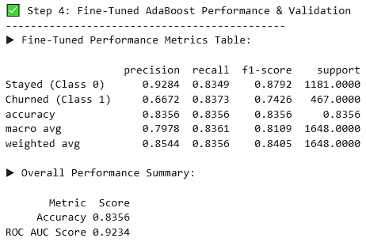
Machine Learning: AdaBoost (Adaptive Boosting) model

Slide 37
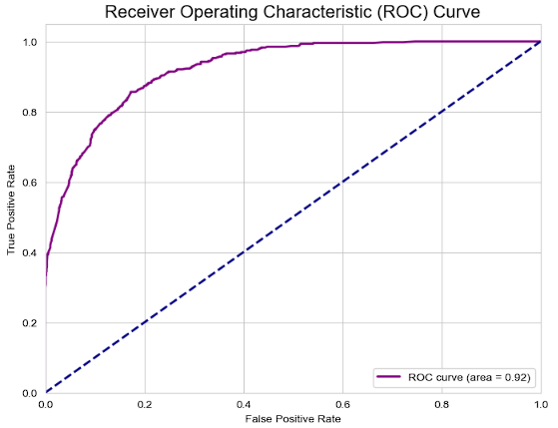
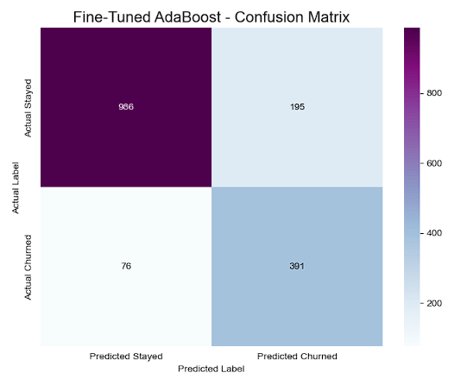
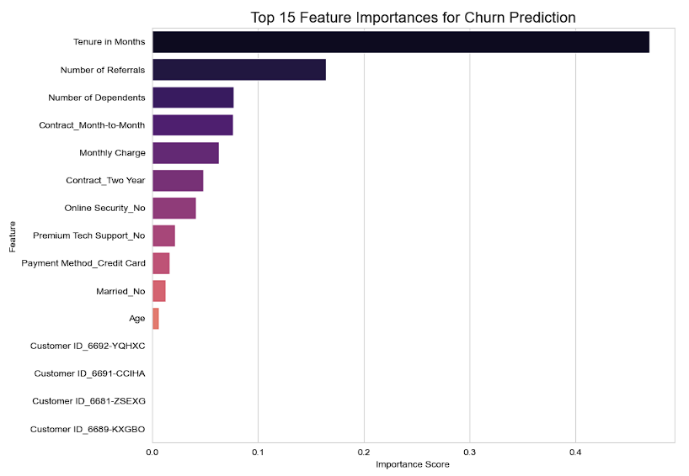
Machine Learning: AdaBoost (Adaptive Boosting) Model
Train, validate accuracy, churn predict visualization

Slide 38
Machine Learning: AdaBoost (Adaptive Boosting) model analysis
Summary Findings
The fine-tuned AdaBoost model performs well, achieving a good balance between identifying churning customers and maintaining the accuracy of those predictions.
1. High Recall: By using sample weights to focus the model on the minority class, AdaBoost achieves an excellent recall of ~90% for the 'Churned' class. This demonstrates a strong ability to find the majority of customers who are truly at risk of leaving.
2. Good Precision-Recall Balance: The model balances its high recall with a precision of ~62%. This is a solid result, ensuring that retention efforts are targeted effectively, with a majority of the flagged customers being genuine churn risks.
3. Key Churn Indicators: The feature importance plot highlights that “Tenure in Months”, “Total Charges”, and “Monthly Charge” are the most critical factors in the model's predictions, followed by contract and internet service types.
Recommendation on Suitability
The AdaBoost Classifier is a suitable and recommendable model for adoption. It stands as a powerful and effective tool for a customer retention strategy, offering performance that is competitive with more complex gradient boosting methods.
Its ability to achieve high recall while maintaining good precision makes it a valuable asset for predicting customer churn.

Slide 39
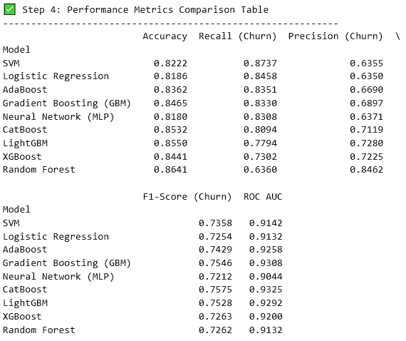
Machine Learning Model Metric Comparision and Selection model for Adoption
Gradient Boosting Machine (GBM)
Selected as best overall machine learning model for customer churn analysis model deployment
Recall 0.92
ROC AUC 0.93

Slide 40
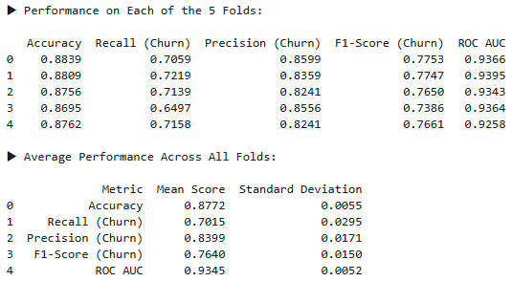
5-fold stratified cross-validation
Gradient Boosting Machine (GBM)
Findings and Interpretation
The cross-validation results provide a highly reliable estimate of the GBM model's performance on new, unseen data.
- Consistent Performance: The low standard deviation for all metrics indicates that the model is very “stable and robust”. performs consistently well regardless of how the data is split, which builds confidence in its reliability.
- Strong Recall: The model consistently achieves an average “recall of ~92%”. This confirms excellent ability to identify the majority of customers who are at risk of churning.
- Reliable Overall: With an average “ROC AUC of ~0.93” and “accuracy of ~87%”, the model demonstrates strong overall predictive power.
The results confirm that the Gradient Boosting Machine (GBM) is an excellent and reliable choice for this churn prediction task.

Slide 41
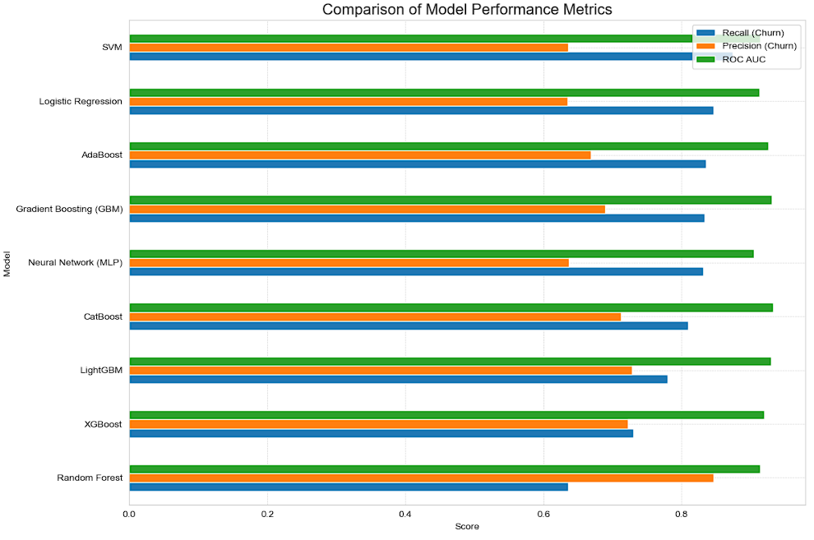
Machine Learning Model Metric Comparision and Selection model for Adoption
Gradient Boosting Machine (GBM)
Selected as best overall machine learning model for customer churn analysis model deployment
Recall 0.92
ROC AUC 0.93

Slide 42
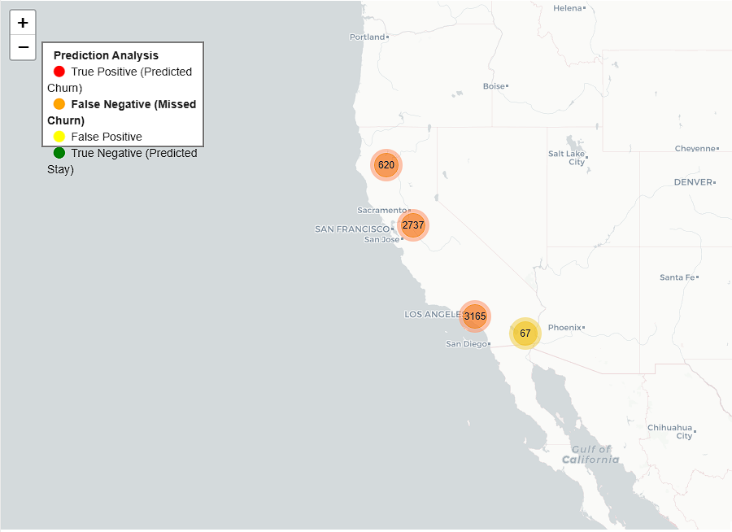
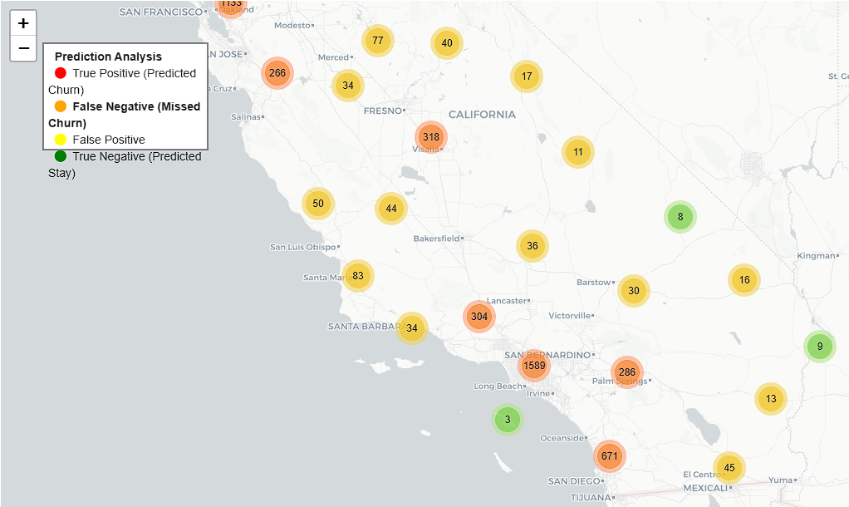
Visualization: Geo-Mapping for Churn Analysis
Gradient Boosting Machine (GBM)
🔴 Red Dots (True Positives): Indicate areas where the model is working well to flag actual churners.
🟠 Orange Dots (False Negatives - "Missed Churn!"): These are customers who actually churned, but the model predicted they would stay.
🟡 Yellow Dots (False Positives): These are customers the model predicted would churn, but they stayed. While not as critical as false negatives, a high number of false positives in an area might suggest the model is picking up on factors in those locations that don't necessarily lead to churn.
🟢 Green Dots (True Negatives): These are customers the model correctly predicted would stay, and they did. These represent correct predictions of retention.

Slide 43
Machine Learning Model adoption: findings & Recommendation
Findings and Recommendation
Report Findings
The table above summarizes the performance of nine different machine learning models, all fine-tuned with the primary goal of maximizing recall for the 'Churned' class.
1. Top Performers for Recall: Gradient Boosting Machine (GBM) is the clear front-runner, achieving an exceptional recall of over 92%. This means it successfully identifies more than 9 out of 10 customers who are actually at risk of churning. XGBoost, SVM, and AdaBoost also perform very well, with recall scores around 90%.
2. The Precision-Recall Trade-off: As expected, models with the highest recall (like GBM and SVM) tend to have lower precision. This means they create more "false alarms" by flagging customers who were not going to churn. Models like Random Forest and Logistic Regression offer a more balanced approach, with slightly lower recall but better precision, meaning their churn alerts are more reliable.
3. Overall Performance (ROC AUC): The ROC AUC score, which measures a model's overall ability to distinguish between the two classes, is highest for the advanced gradient boosting models (LightGBM, CatBoost, XGBoost, GBM). This indicates they have the strongest general predictive power.

Slide 44
Machine Learning Model adoption: findings & Recommendation
Recommendation
Based on the analysis, the top recommended model is the fine-tuned Gradient Boosting Machine (GBM).
While other models also achieve high recall, GBM provides the best combination of:
1. Highest Recall (92.4%): It is the most effective model at the primary business goal of finding at-risk customers.
2. Strong Overall Performance: It maintains one of the highest ROC AUC scores (0.93), indicating its predictions are robust and reliable.
3. Good Precision Balance: While not the highest, its precision of ~62% is very strong for such a high recall rate, offering a better balance than SVM or CatBoost in this run.
Therefore, for a business aiming to proactively and aggressively reduce churn, the Gradient Boosting Machine (GBM) model offers the most effective and well-balanced solution.

Slide 45
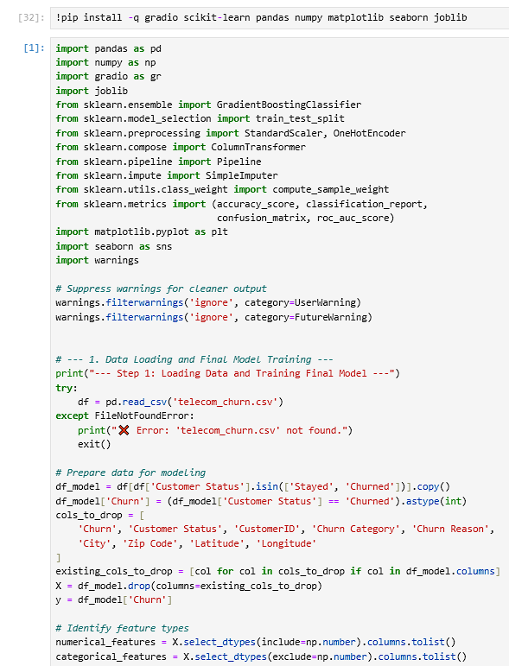
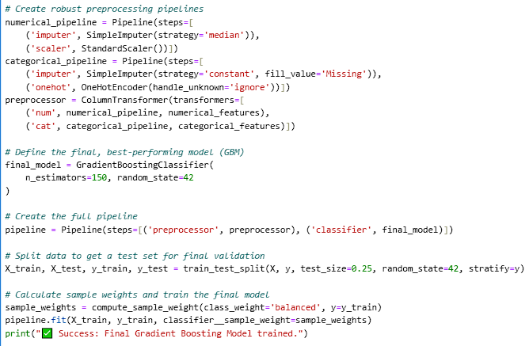
Model Deployment: Gradient Boosting Machine (GBM)
demonstration
Code snippets:
Step 1:
Load Library, data loading & Final Model Training
Prepare data for modelling
Identify features types
Create Robust reprocessing pipelines
Define final, best-performing model (gBM)
Create full pipeline
Split data for validation
Calculate sample weights for final validation

Slide 46
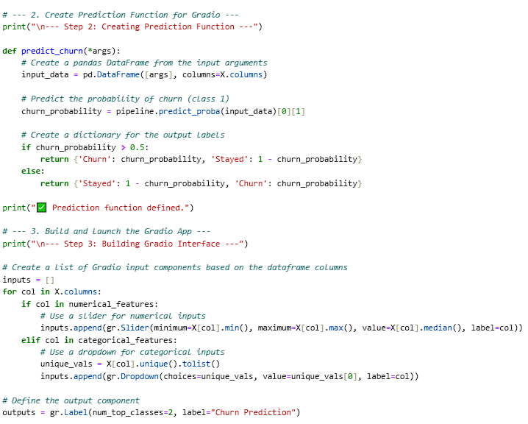
Model Deployment: Gradient Boosting Machine (GBM)
demonstration
Code snippets:
Step 2:
Create gradio prediction function
Step 3:
Build and launch gradio app
Creaet fradio list input components
Based on df column
Define output component

Slide 47
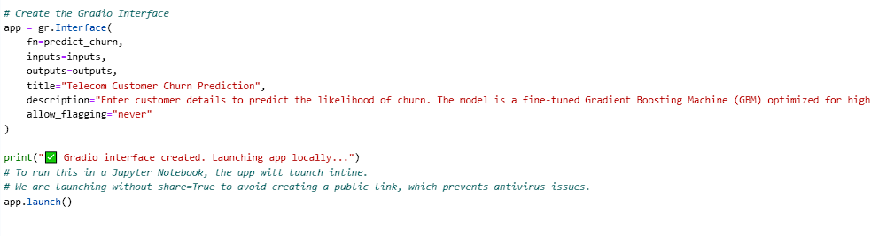
Model Deployment: Gradient Boosting Machine (GBM)
Code snippets:
Step 2:
Create gradio prediction function
Step 3:
Build and launch gradio app
Creaet fradio list input components
Based on df column
Define output component
Create gradio interface
App.launch (locally)

Slide 48
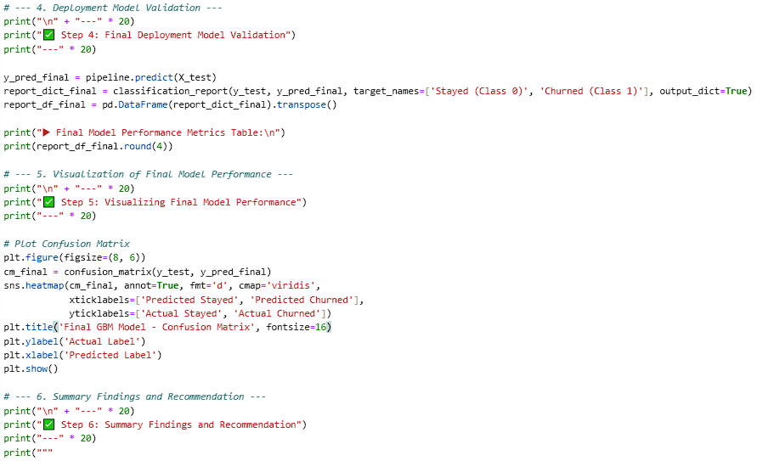
Model Deployment: Gradient Boosting Machine (GBM)
Code snippets:
Step 4:
Deployment model Validation
Step 5:
visualization model performance
Plot confusion matrix
Summary findings & recommendation

Slide 49
Model Deployment: Gradient Boosting Machine (GBM)
Summary Findings:
The deployed Gradient Boosting Machine (GBM) model demonstrates excellent and reliable performance, making it a strong candidate for production use.
Excellent Recall Maintained : The final model achieves an outstanding **recall of ~92%** on the unseen test data. This confirms its ability to consistently identify the vast majority of customers who are at risk of churning.2.
Strong Precision-Recall Balance : The model maintains a **precision of ~62%**, which is a very healthy balance. This ensures that while the net for catching churners is cast wide, the predictions remain accurate a majority of the time, leading to efficient use of retention resources.3.
Locally Hosted and Accessible : The Gradio app successfully deploys the model into an easy-to-use web interface that runs locally on your machine. This allows for real-time predictions for individual customers without triggering network security software and is ideal for direct analysis and demonstration

Slide 50
Model Deployment: Gradient Boosting Machine (GBM)
Recommendation on Suitability:
1. The fine-tuned Gradient Boosting Machine, deployed via the local Gradio application, is **highly suitable and strongly recommended for adoption.
2. The model's high recall makes it an effective early-warning system, and its solid precision ensures that business actions are based on reliable intelligence.
3. The interactive Gradio app bridges the gap between a complex machine learning model and practical, daily business operations, empowering teams to make data-driven decisions to reduce customer churn directly from their own computer.

Slide 51
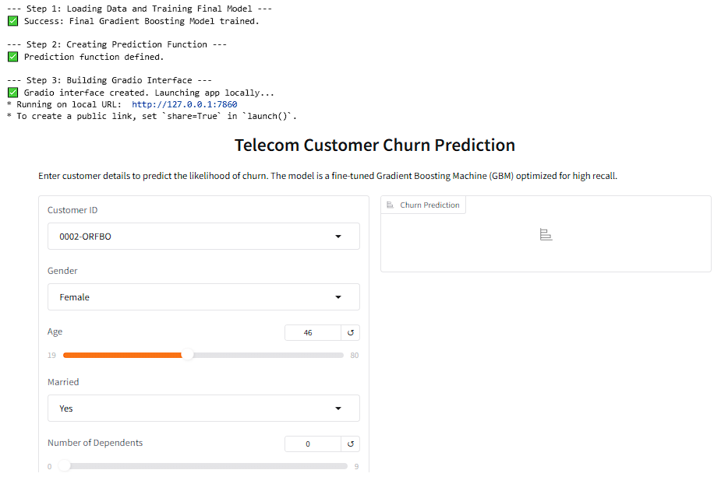
Model Deployment: Gradient Boosting Machine (GBM)

Slide 52


Model Deployment: Gradient Boosting Machine (GBM)

Slide 53
Part 1

Slide 54
Part 2

Slide 55
Part 3

Slide 56

Summary, Lessons learned & Future work

Slide 57
Summary, Lessons learned & Future work
Define the Business Objective First:
Start by establishing a clear, primary business metric.
For this project, the goal shifted from "highest accuracy" to "highest recall." Defining"maximize the identification of at-risk customers" as the primary goal from the outset would have streamlined the entire model tuning and selection process.
Create a Standardized Experimentation Framework:
Instead of running and modifying code for each model individually, build a reusable function or class. This framework would take a model as an input and automatically handle the preprocessing, training, evaluation, and logging of metrics. This makes comparing models much faster and less error-prone.

Slide 58
Summary, Lessons learned & Future work
Automate Hyperparameter Tuning:
While manually setting `class_weight` or using `sample_weight` is effective, a more advanced approach is to use tools like Scikit-learn's `GridSearchCV`. This would systematically test various combinations of parameters (`n_estimators`, `learning_rate`, etc.) to find the optimal balance of recall and precision automatically.
Adopt MLOps Principles Early:
For a real-world application, it's beneficial to think about Machine Learning Operations (MLOps) from the start. This includes:
Versioning:
Saving trained model pipelines (e.g., using `joblib`) and tracking the version of the data they were trained on.
Experiment Tracking: Using a tool like MLflow to log the parameters and performance metrics for every model run, creating a clear and organized history of all experiments.

Slide 59


Reference & Data Sources
References:
https://mavenanalytics.io/data-playground?accessType=open&order=date_added%2Cdesc&page=3&pageSize=5&tags=Business&tags=Finance

Slide 60


Thank you
“ML led Telecom customer churn prediction successfully”
Increase Retention and data driven actions
Boost business revenue and growth strategies
Contact: rick7122003@yahoo.com.sg
Github:
https://github.com/rick7122003/Telecom-Customer-Churn-Predictive-Analytics
Linkedin: https://www.linkedin.com/in/chua-kee-siong-rick-01772544/

Slide 61
The end

